Slide 1
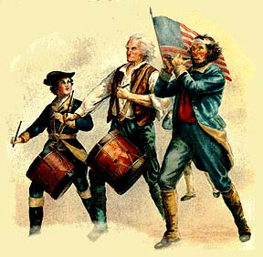
American Revolution Battles
4th grade

Slide 2
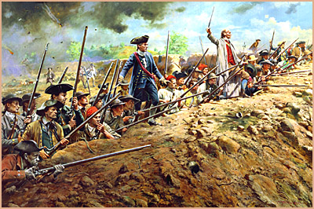
Battle of Bunker Hill
Boston, MA
June 17, 1775

Slide 3
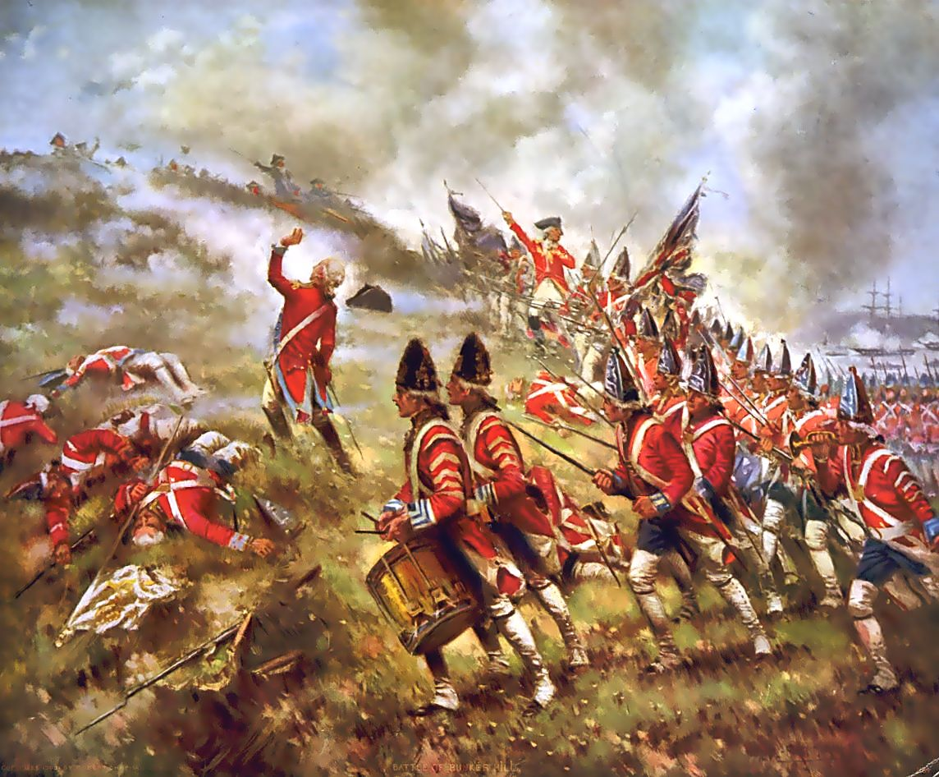
Colonists position themselves on top of a hill and build earthworks to hide behind. Colonists are low on ammunition so they wait until they see the whites of their eyes to fire.

Slide 4
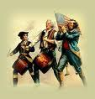
British rush the hill 2 times with NO success. When they rush the hill the third time, the British win because the colonists retreated when they ran out of ammunition.
Why were they ordered to see the whites of their eyes before they were to fire?

Slide 5
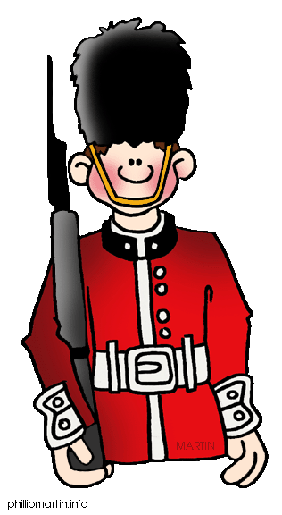
Outcome of the Battle of Bunker Hill
British lost many men. British realized colonists were really going to fight. Colonists knew they could beat the mighty British Army if they fought smartly.
In your own words, state the description of the Battle of Bunker Hill and explain who gained power.

Slide 6
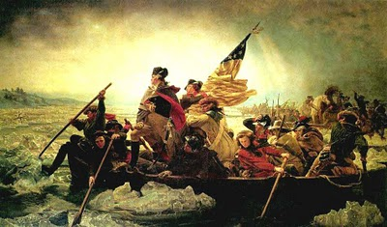
Battle of Trenton
December 25, 1776

Slide 7
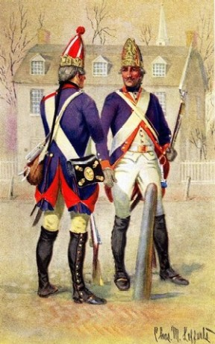
The Patriots crossed the Delaware River in rowboats. Then they marched ten miles to Trenton, New Jersey. The Hessian troops were sleeping. The Hessians were German soldiers who were helping the British. They were known to be “giants” because they were larger than the average British person. The fighting only lasted for one hour before the Hessians surrendered.

Slide 8
Outcome of the Battle of Trenton
The Patriot soldiers won!!
This gave the soldiers hope for the future.
Why do you think that George Washington chose Christmas night for his attack? How did this attack give more power to the colonists?

Slide 9
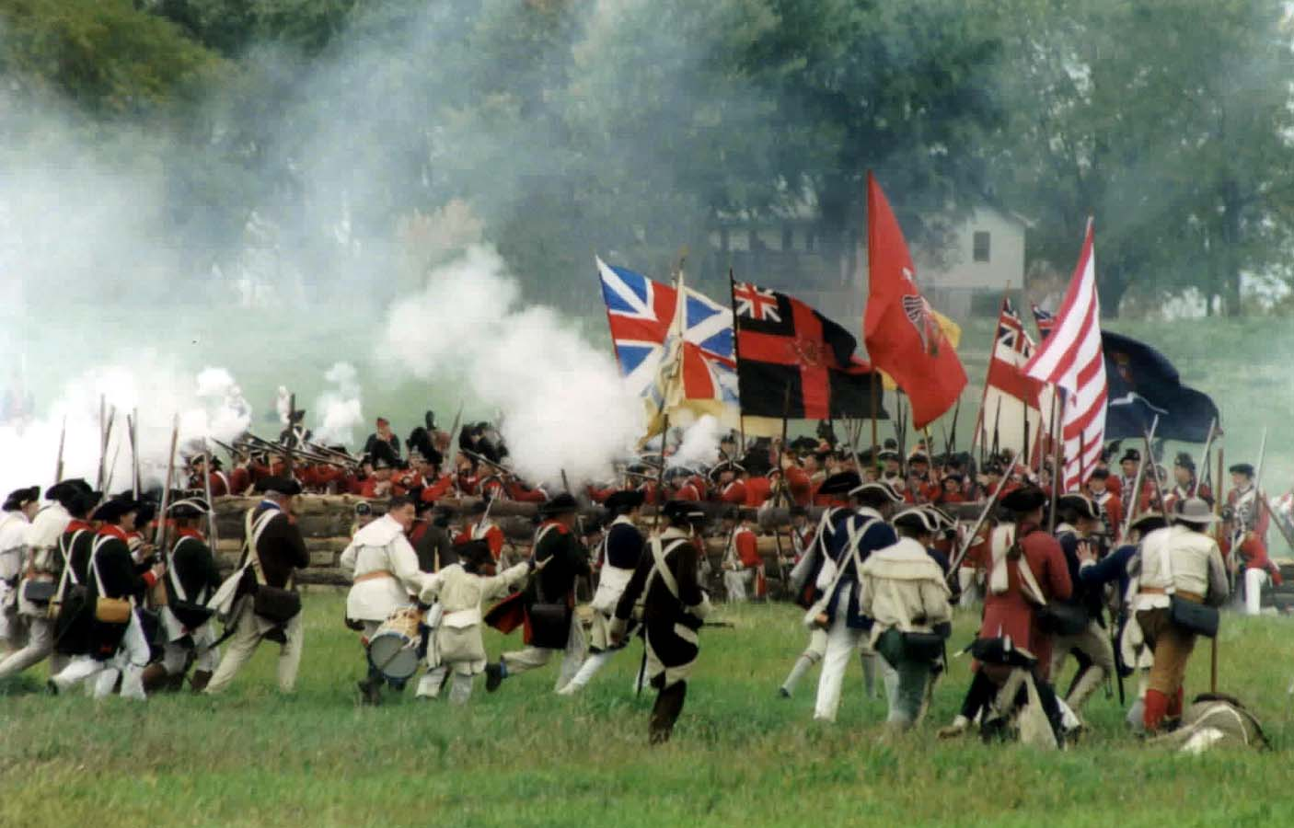
Battle of Saratoga
Saratoga, New York
October, 17, 1777

Slide 10
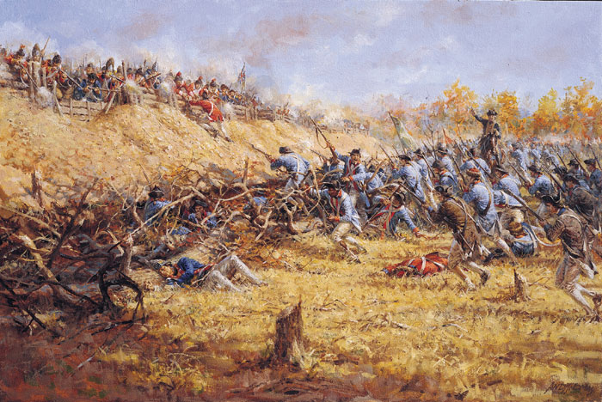
British strategy was to cut the colonies in two. It didn’t work because one army did not show up, one army arrived late, and the last army was easily defeated.

Slide 11
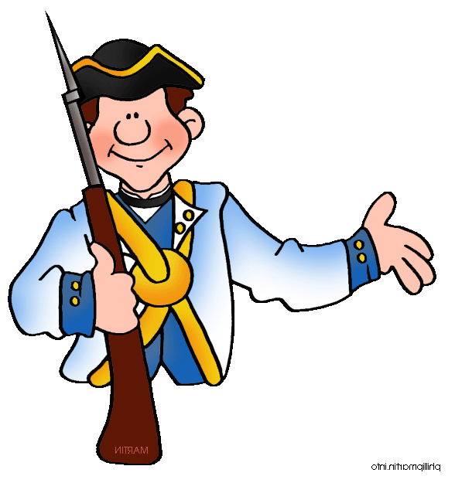
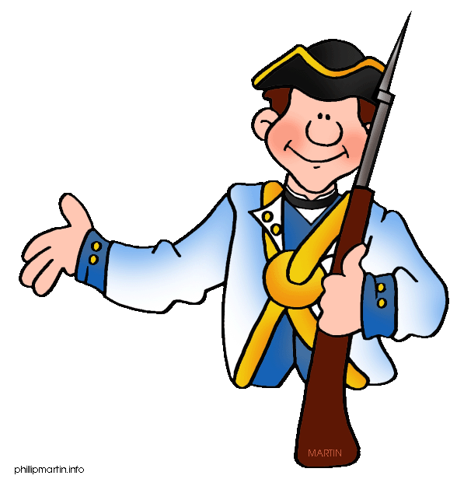
Outcome of the Battle of Saratoga
Colonial Army WON!!
France decided to help out the colonists.
This was a turning point.
Create a simile describing the outcome of the Battle of Saratoga

Slide 12
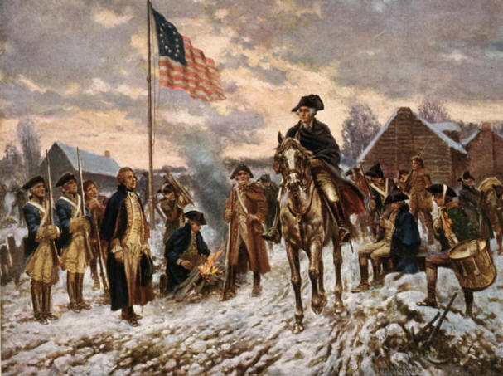
Winter at Valley Forge
Winter of 1777- 1778

Slide 13
Washington and his troops stayed in Valley Forge, PA during the winter. Many died of hunger, disease, or from the harsh weather. Many also deserted (left) the army.

Slide 14
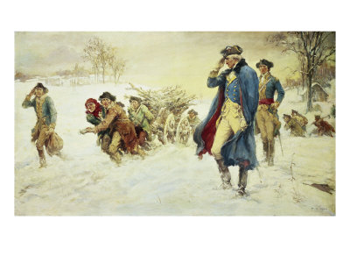
Outcome of Winter at Valley Forge
Colonial army nearly crumbled because they lost so many soldiers.
Those who stayed, trusted General Washington to lead them to victory.
How do you think things might have been different for the soldiers if this had happened in the summer ?

Slide 15
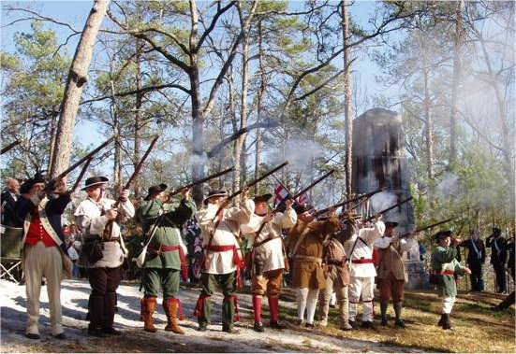
Battle of Kettle Creek
February 14, 1779
Kettle Creek, Georgia

Slide 16
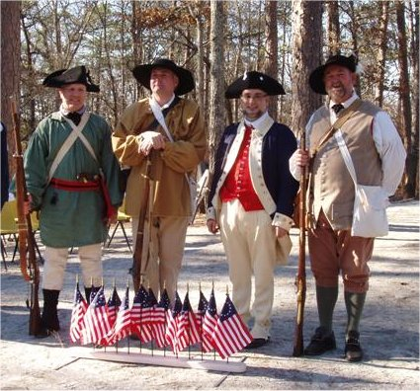
It was a small battle on the banks of Kettle Creek. The Patriots outnumbered the British by 2:1. The Patriots surprise attacked the British.

Slide 17
Outcome of Battle of Kettle Creek
This battle was a moral booster because it gave the colonists confidence that they could win the war after all.
Patriots won the battle and this kept the British from taking over Georgia.
How would you feel if you were living in Georgia at this time and your dad had fought in this battle?

Slide 18
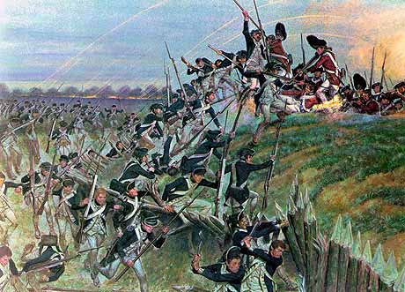
Battle of Yorktown
Yorktown, VA
October 19, 1781

Slide 19
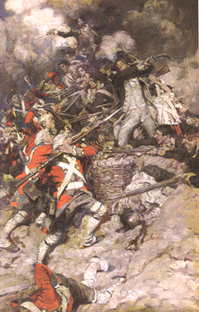
British Army sets up camp on a peninsula. Washington’s army blocks them in to the west and the French navy blocks them in to the east. They are trapped.

Slide 20
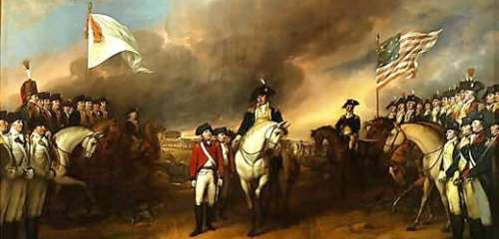
Outcome of Battle of Yorktown
British General Cornwallis surrenders to General Washington.
Colonial army won the war.
Colonists are free from British rule.

