Slide 1
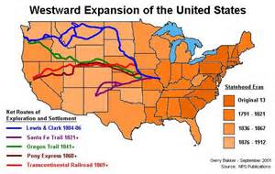
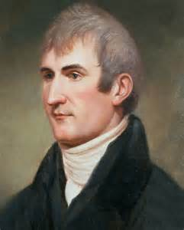
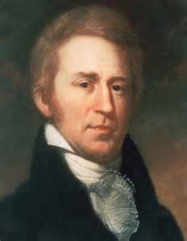
Westward Expansion: Lewis and Clark
Meriwether Lewis William Clark

Slide 2
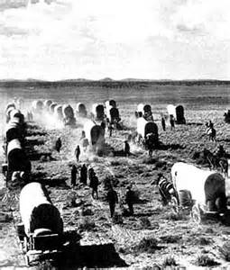
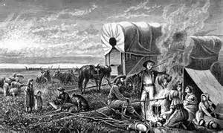
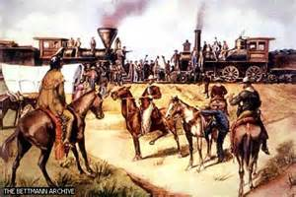
Westward Expansion was from 1801 to 1861. Americans began to explore more territories to expand the U.S.
Main Territories explore:
Louisiana Purchase (1803)
Florida (1819)
Texas (1845)
Oregon (1846)
California (1848)

Slide 3
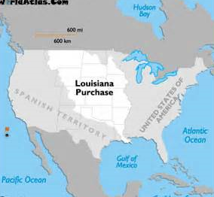
2. Louisiana Purchase was a deal made by President Jefferson in 1803. He bought land from France that doubled the size of the U.S.
This is the land Lewis and Clark were sent to explore.

Slide 4
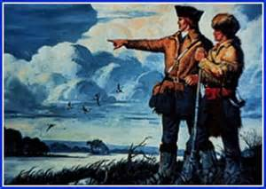
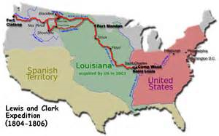
3. Lewis and Clark Expedition started on the Mississippi River to the Missouri River. Then they went to the Rocky Mountains and did not stop until they reached the Pacific Ocean.

Slide 5
4. Meriwether Lewis was Thomas Jefferson’s personal secretary who the commander of the expedition.
5. William Clark was a frontiersman who could draw maps, navigate rivers, and understand geography.

Slide 6
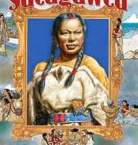
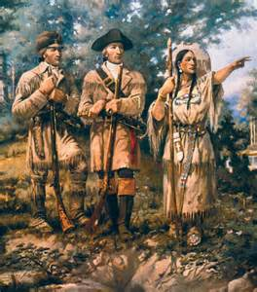
6. Sacagawea was a Native American who guided and helped Lewis and Clark to the Pacific Ocean.
Sacagawea was Shoshone Indian who was pregnant when she joined the Corps of Discovery group in North Dakota on the Missouri River. She communicated with other natives for horses to travel over the Rocky Mountains; A Shoshone Chief, her brother.

Slide 7
REVIEW
PHYSICAL FEATURES
OF THE
UNITED STATES

Slide 8
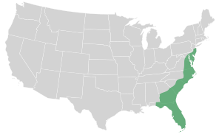
Atlantic Coastal Plain
This lowland area borders the Atlantic Ocean in the eastern part of the United States.
It has many excellent harbors. Many people live in the Atlantic Coastal Plain Region.

Slide 9
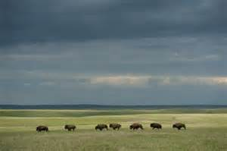
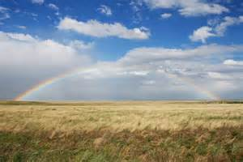
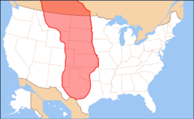
Great Plains
The flat area in the middle of the United States, west of the Interior Plains and east of the Rocky Mountains.
This area consists of grasslands with no trees, and you can see for miles and miles.

Slide 10
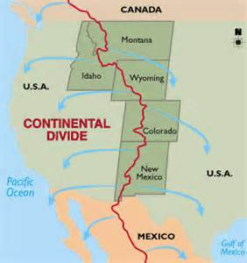
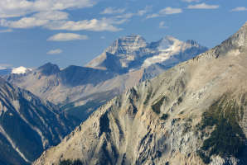
Continental Divide
The high peaks of the Rocky Mountains form this imaginary line known as the “backbone of North America”.
On the eastern side of the divide, rivers flow toward the Atlantic Ocean or the Gulf of Mexico. On the western side, rivers flow toward the Pacific Ocean.

Slide 11
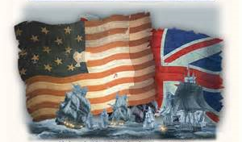
Westward Expansion: War of 1812
America England

Slide 12
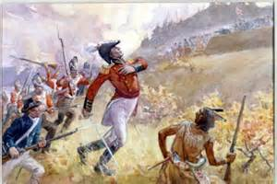
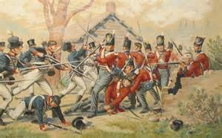
1. War of 1812 was a war between America and England. France helped America as the Native Americans helped England. The war ended in 1814 with a “draw”, both sides claimed victory.

Slide 13
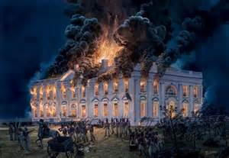
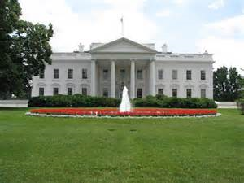
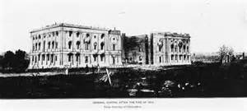
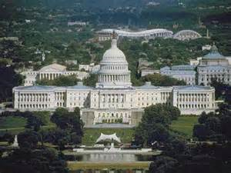
2. White House is the U.S. President’s house in Washington, D.C. It was burnt down during the War of 1812 and later rebuilt.
3. Capitol Building is the place where the U.S. Congress meet. It was burnt down during the War of 1812 and later rebuilt.

Slide 14
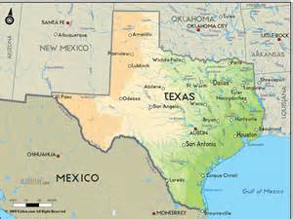
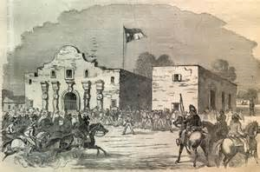
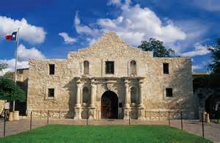
4. Texas is a state the U.S. fought Mexico for during the Westward Expansion. Texas joined the U.S. in 1845.
5. Alamo was a Spanish mission in Texas where a famous battle took place between America and Mexico during Westward Expansion.

Slide 15
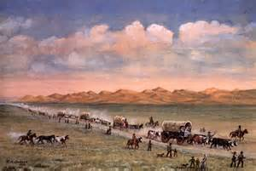
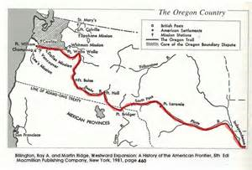
6. Oregon Trail was a well-marked trail to show pioneers the way out west in covered wagons.

Slide 16
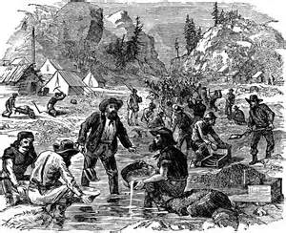
7. California is a state the U.S. fought Mexico for during the Westward Expansion. California joined the U.S. in 1848.
8. California Gold Rush was in 1848 when gold was discovered. Many people began traveling out west to find gold.

Slide 17
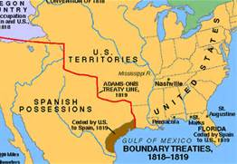
9. Florida was a piece of land turned over by Spain to the United States in 1819.

Slide 18
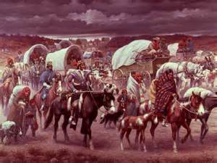
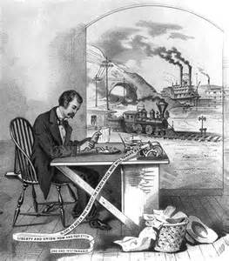
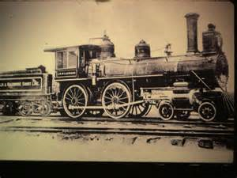
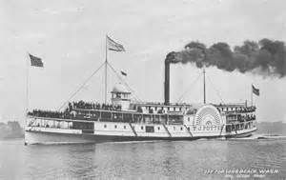
Westward Expansion: Barriers and Gateways

Slide 19
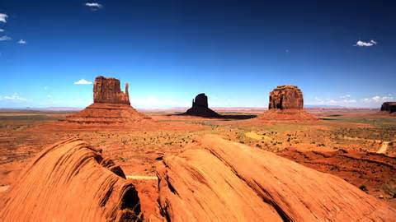
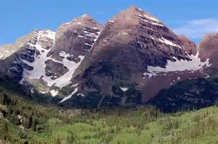
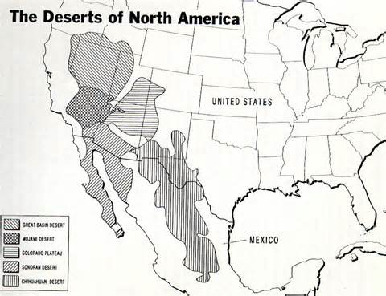
1. Physical Barriers are landforms that hindered expansion such as the Rocky Mountains and deserts.
The Great Basin

Slide 20
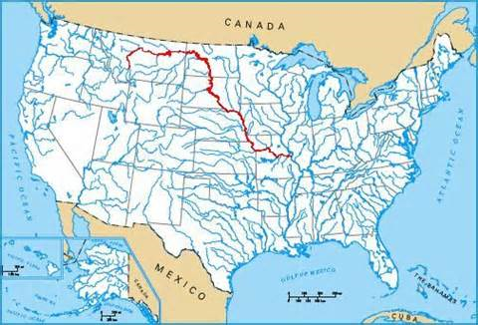
2. Physical Gateways are landforms that benefited expansion such as the Great Lakes, Missouri River, and the Great Plains.
Great Lakes
Missouri River
The Great Plains

Slide 21
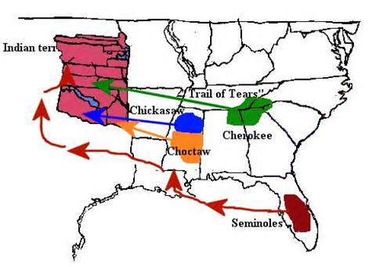
3. Territorial Expansion is the growth of a territory across the country.
4. The Indian Removal Act of 1830 was a treaty with Native Americans to exchange land across the Mississippi River; however,
the Indians
were forced off
their land.
MISSISSIPPI RIVER

Slide 22
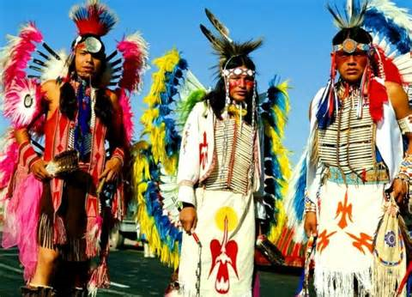
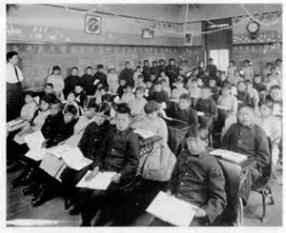
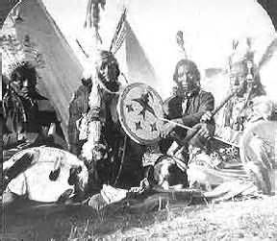
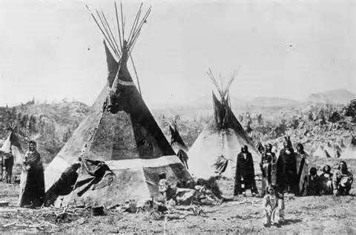
5. The Americanization Policy was designed to introduce Indians to the European-American ways of life and combine them with their own tribal traditions.

Slide 23
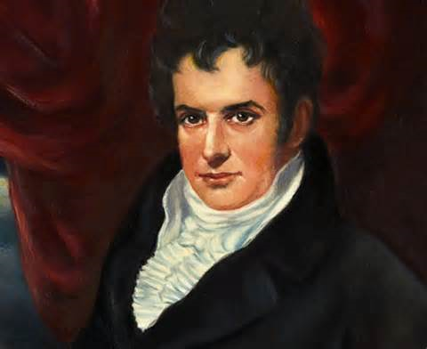
6. Invention is an object that has never been made before.
7. Steamboat was an invention by Robert Fulton in 1807 to transport people and goods on rivers and canals.

Slide 24
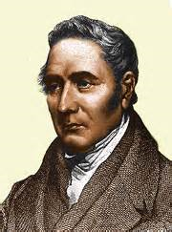
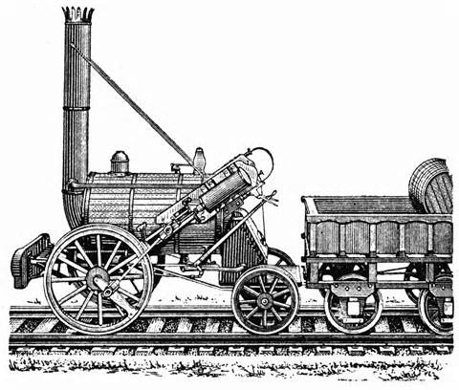
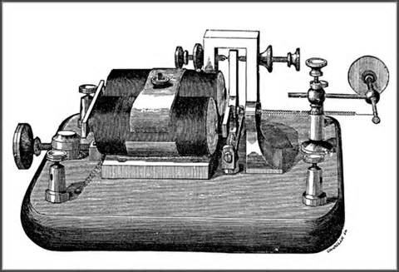
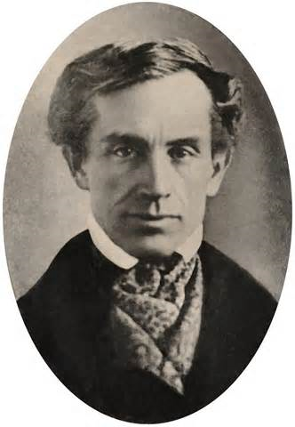
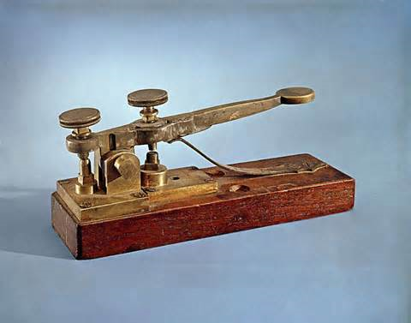
8. Steam Locomotive was an invention by George Stephenson in 1814 to transport raw materials and goods quickly over land.
9. Telegraph was an invention by Samuel Morse in 1837 to provide long distance communication.

