Slide 1
Industrial Revolution

Slide 2
Changes in Transportation
Steamboats
August 9, 1807 - first steamboat travels up the Hudson River
Powered by steam, not oars, wind, or water currents
First steamboat traveled from New York City to Albany, New York in a record 32 hours
https://www.google.com/maps/dir/New+York,+NY/Albany,+NY/@41.6847556,-74.9674414,8z/data=!3m1!4b1!4m14!4m13!1m5!1m1!1s0x89c24fa5d33f083b:0xc80b8f06e177fe62!2m2!1d-74.0059413!2d40.7127837!1m5!1m1!1s0x89de0a34cc4ffb4b:0xe1a16312a0e728c4!2m2!1d-73.7562317!2d42.6525793!3e0
Because roads were so poor at this time, rivers and canals were the fastest and cheapest ways to ship goods.
Canal: waterways built for travel and shipping

Slide 3
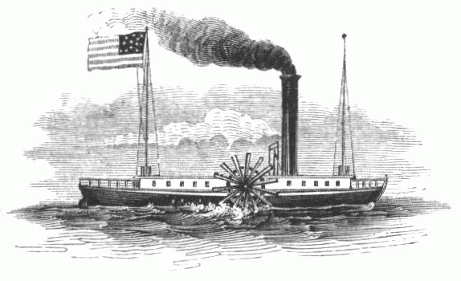

Slide 4
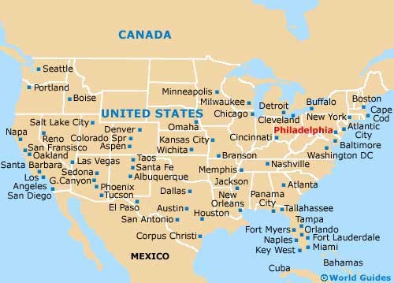
Philadelphia, Pennsylvania

Slide 5
Philadelphia, Pennsylvania
1800 - largest city in U.S. (over 60,000 people)
Became one of the first U.S. industrial cities because of its busy port
https://www.google.com/maps/place/Philadelphia,+PA/@39.9142368,-75.2427061,10z/data=!4m2!3m1!1s0x89c6b7d8d4b54beb:0x89f514d88c3e58c1
Financial center of the U.S.
First mint was in Philadelphia
First and second bank in Philadelphia

Slide 6
Philadelphia, Pennsylvania
Philadelphia’s shipping industry was messed up by the War of 1812 and never regained its power after the war.
New York became the next major city

Slide 7
The Erie Canal
Opened in 1825
Connected the Hudson River and Lake Erie
363 miles long

Slide 8
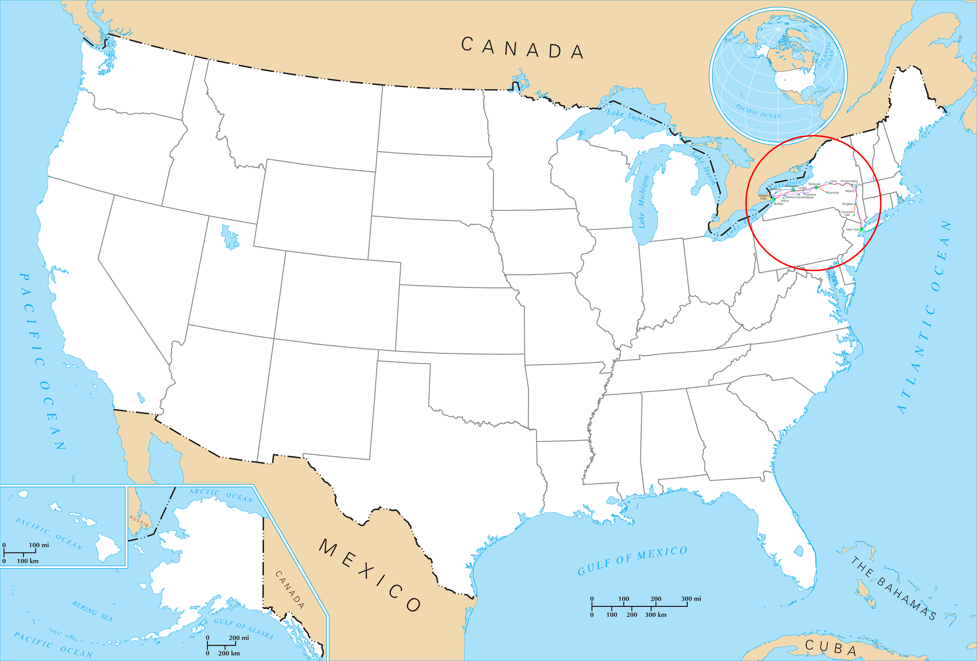
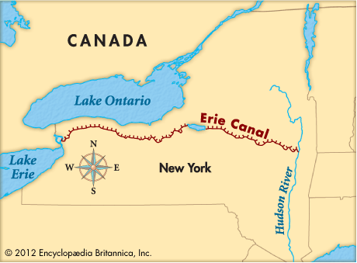
The Erie Canal

Slide 9
Erie Canal and New York City
With the invention of steamboats and canal systems (Erie Canal especially), New York became the largest city with the busiest port
The Erie Canal connected the urban port with the agricultural markets inside the United States

Slide 10
Railroad
By the 1850s, there were 9,000 miles of railroad track in the U.S.
A trip from New York City to Albany, New York would take 32 hours by steamboat and only 10 hours by train
Railroads were used for transporting:
food
clothes
supplies
people

Slide 11
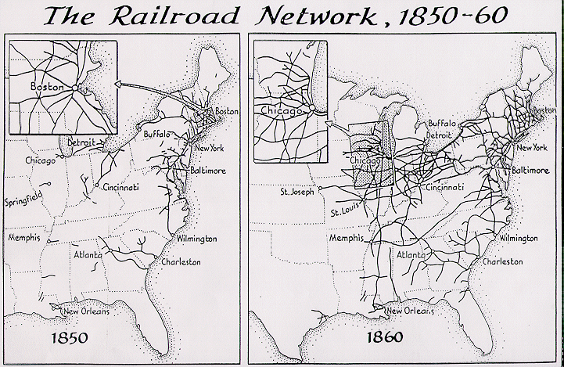
Railroad

Slide 12
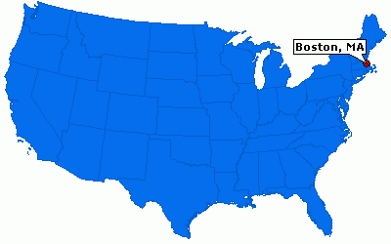
Boston, Massachusetts

Slide 13
Boston, Massachusetts
1800s - Boston grew to a large seaport
Why? Because the railroads and steamboats made transporting goods across the country easy and quick
Boston is surrounded by several small rivers that connect the city to other regions. Shipping products made in Boston was easy
https://www.google.com/maps/place/Boston,+MA/@42.3657775,-71.0544105,13z/data=!4m2!3m1!1s0x89e3652d0d3d311b:0x787cbf240162e8a0

Slide 14
Boston, Massachusetts
1850s - The growing railroad system made Boston a huge international seaport
Boston was one of the country’s largest manufacturers of clothing, leather goods, and machinery

