Slide 1
U.S. Constitution
Preamble

Slide 2
Purpose of the Preamble
The Preamble of the Constitution establishes what the founding fathers wanted to do with our new government
It is like an introduction paragraph (states the purpose)
There are six goals established in the Preamble

Slide 3
“We the People…”
Popular Sovereignty – the people are in charge of the government
In 1787, there were 3,894,000 people in the country
Currently, there are 308,794,894 people in the country

Slide 4
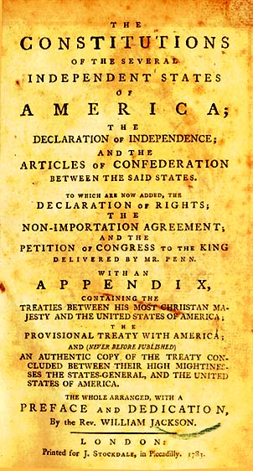
Goal #1
“In order to form a more perfect union…”
This is the writers of the Constitution stating that the original government, the Articles of the Confederation, did not work.

Slide 5
Goal #2
“Establish justice…”
All of the laws that are created under the new constitution must be fair and reasonable for all citizens to follow.

Slide 6
Goal #3
“Insure domestic tranquility…”
Under the Articles of Confederation, the states were often in arguments with each other
With the creation of the new constitution, the founding fathers wanted to create peace within the new nation

Slide 7
Goal #4
“Provide for the common defense…”
The new nation realized that to be able to defend themselves, they needed to create a strong army and navy.

Slide 8
Goal #5
“Promote the general welfare…”
The individual governments of the states needed to come together for the well-being of the country as a whole

Slide 9
Goal #6
“And secure the blessings of liberty for ourselves and our posterity… do ordain and establish this Constitution for the United States of America”
Posterity – descendents… children or future family members
Establish – set up or create

