Slide 1
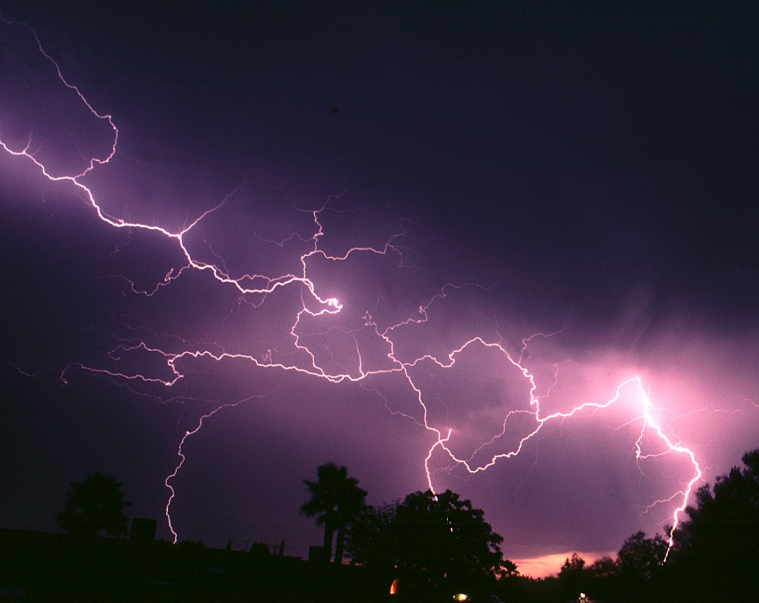
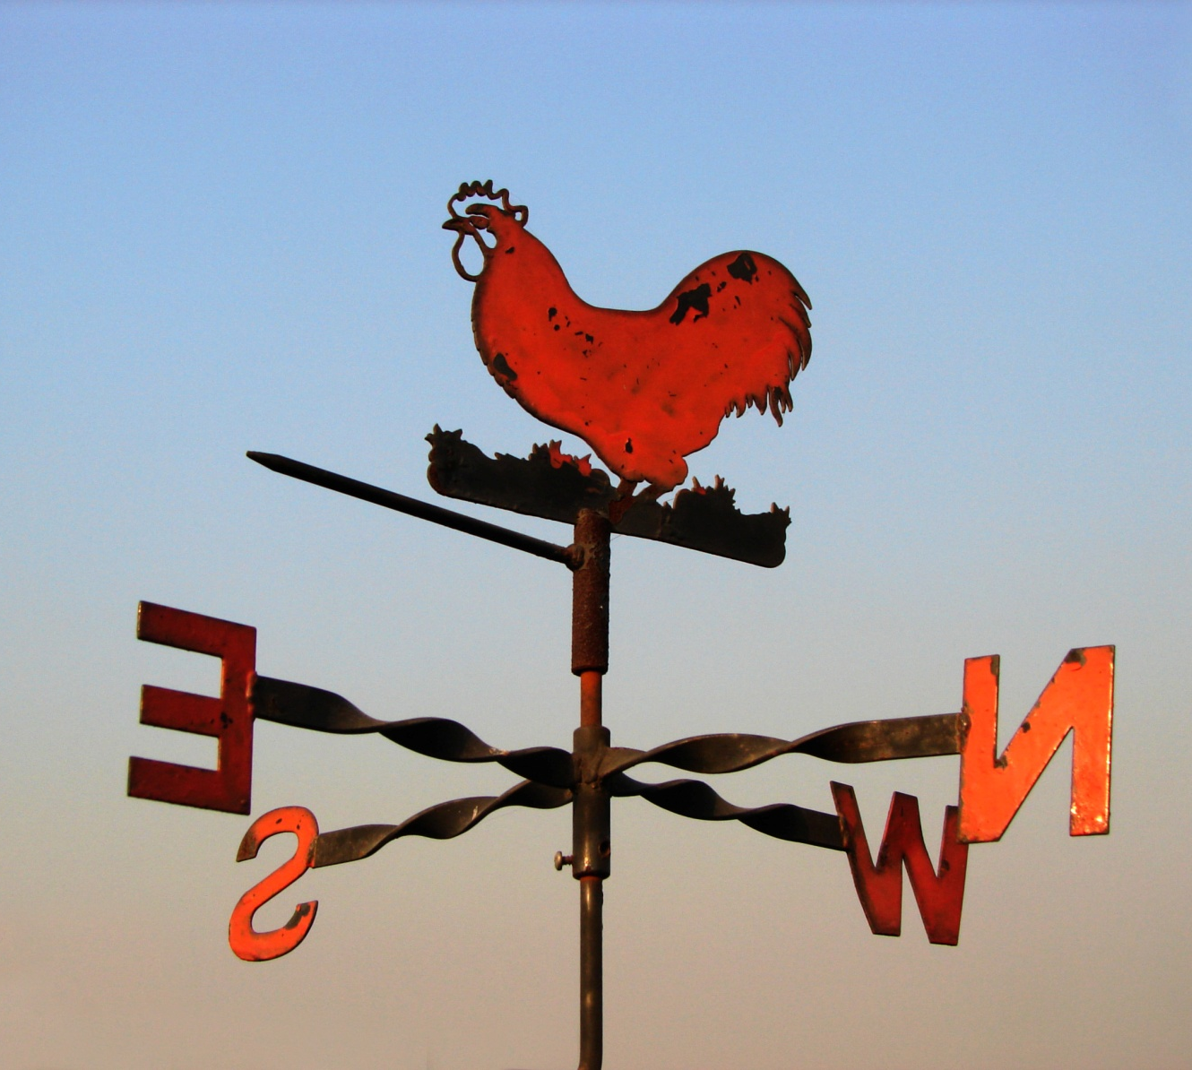
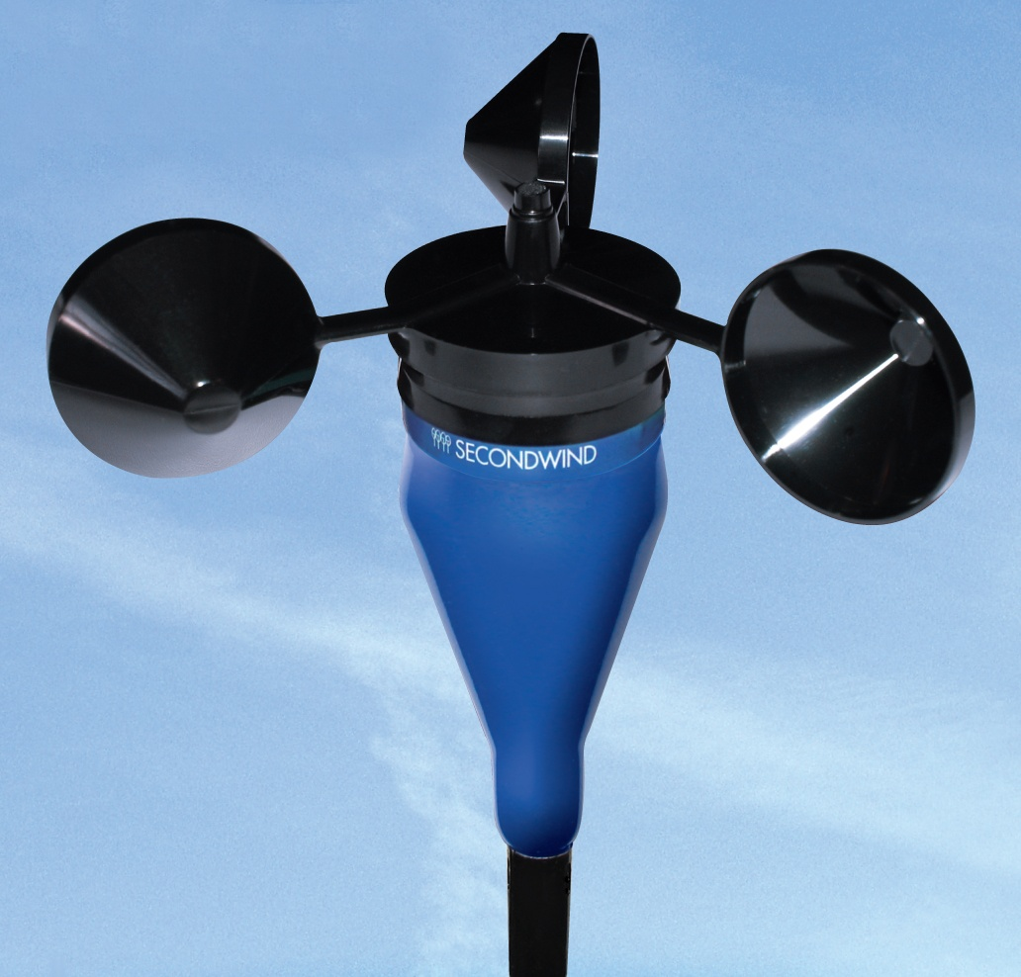
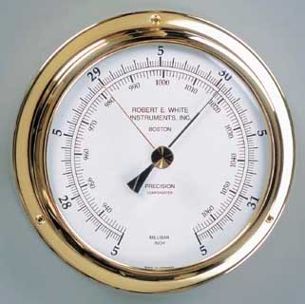
Weather and Weather Tools

Slide 2
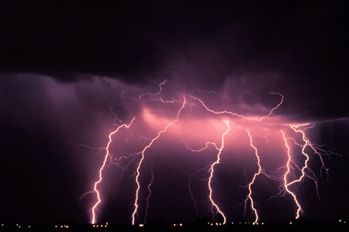
What Makes Up Weather?
Weather changes all the time. Measuring weather Helps people predict weather accurately.

Slide 3
Weather is what the air is like outside. it includes the following:
the kinds of clouds in the sky
kind and amount of water
temperature of the air
how the wind is blowing.

Slide 4
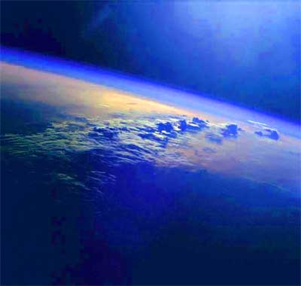
The atmosphere is the blanket of air that surrounds the Earth.
Weather happens in the lower part of the atmosphere.

Slide 5
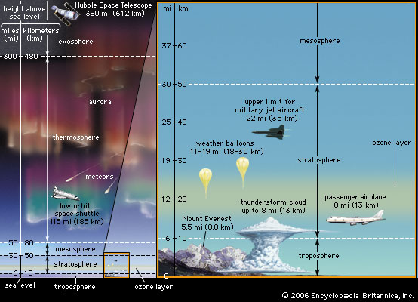

Slide 6
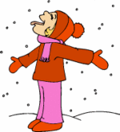
What description of weather is this an example of?
the kinds of clouds in the sky
kind and amount of water
temperature of the air
how the wind is blowing

Slide 7
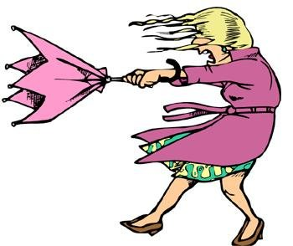
What description of weather is this an example of?
the kinds of clouds in the sky
kind and amount of water
temperature of the air
how the wind is blowing

Slide 8
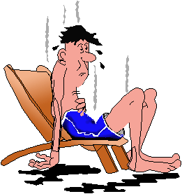
What description of weather is this an example of?
the kinds of clouds in the sky
kind and amount of water
temperature of the air
how the wind is blowing

Slide 9
Tools for Measuring Weather
Barometer
this tool measures air pressure

Slide 10
Tools for Measuring Weather
Anemometer
this tool measures wind speed

Slide 11
Tools for Measuring Weather
Wind vane
this tool measures wind direction

Slide 12
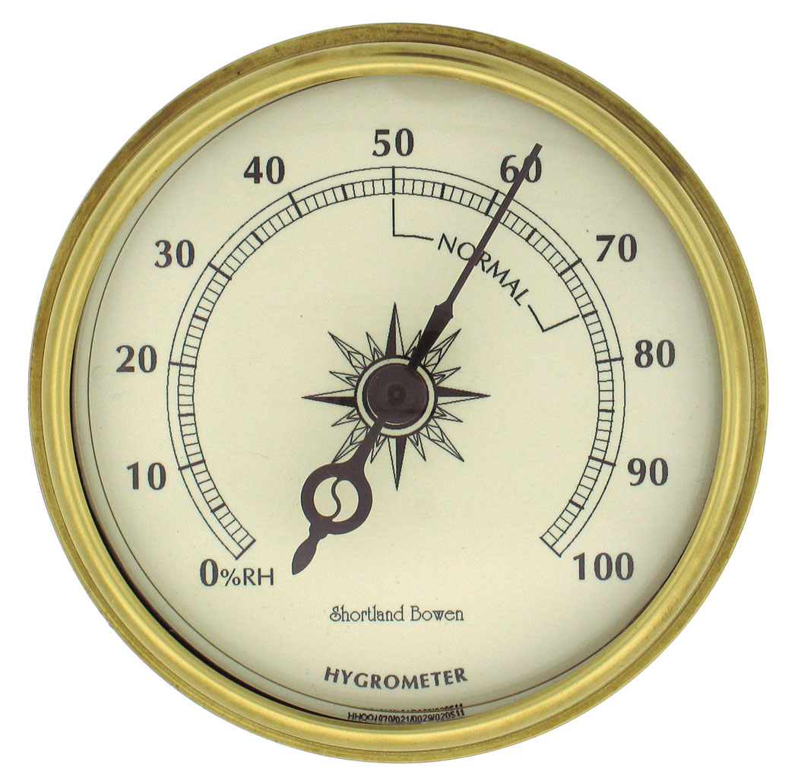
Tools for Measuring Weather
Hygrometer
this tool measures how much water is in the air

Slide 13
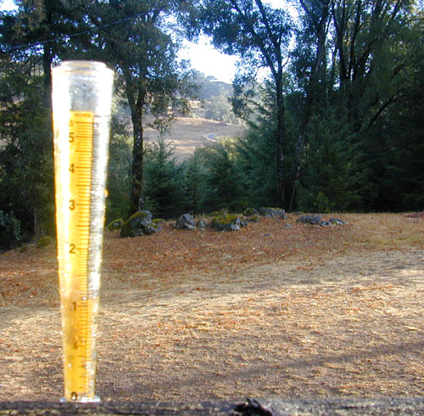
Tools for Measuring Weather
Rain gauge
this tool measures how much rain has fallen

Slide 14
this tool measures how much water is in the air
Rain gauge
Hygrometer
this tool measures wind direction
Wind vane
this tool measures air pressure
Anemometer
this tool measures wind speed
Barometer
this tool measures how much rain has fallen
Match the tool with the definition

Slide 15
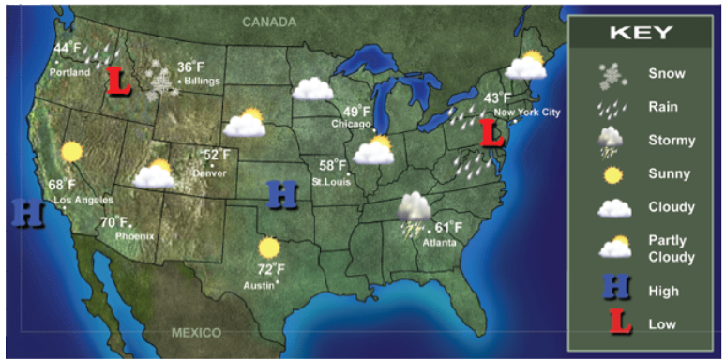
Look at the weather map below! the numbers show the temperature in different cities. What can you learn from this map?
Weather Maps
Weather tools gather data. Scientists show this on weather maps.
They show temperature and storms. Some give information about
areas of high and low pressure.

Slide 16
Way to go!

Slide 17
Sorry! Try again!

